Slide 1
Library management system
Simple solution for tracking books

Slide 2
Consultant Md. Moshaidul Islam wdpf.idb-bisew IT scholarship Email : moshaidul@gmail.com
Instructor
Farhana Akter Lucky
wdpf.idb-bisew IT scholarship Email : farhanawdpf@gmail.com

Slide 3
Developed by MD Mishkatul Islam
ID:1273060
Round:54/NCLC

Slide 4
Sep 27, 2023, The Consultant WDPF, IDB-BISEW IDB Bhaban Sher-e-Bangla Nagar, Dhaka. Subject: Project proposal letter for library Management System Dear Sir, Thank you for offering me a great opportunity to make a real-life project based on our core course that is Web Development with PHP and Framework (WDPF). In this respect, I would like to inform you that I have decided to make a project on library Management System, which is most importance for every office communities. I have studied about the various aspects of this system and make a proposal accordingly which is enclosed herewith for your kind perusal. So, I think you will finally Approved the project and help to utilize my creativity. Sincerely, Mishkatul islam, Trainee ID:1273060 Batch: WDPF/NCLC-M/54/01 Round: 54

Slide 5
Introduction
The purpose of this project proposal is to outline the development of an Library Management System using react and php. This system aims to streamline and automate various aspects of Library management, including exam information, student tracking, books management, and performance evaluation. By implementing this system, a organization will improve efficiency, reduce manual paperwork, and enhance overall Library satisfaction.

Slide 6
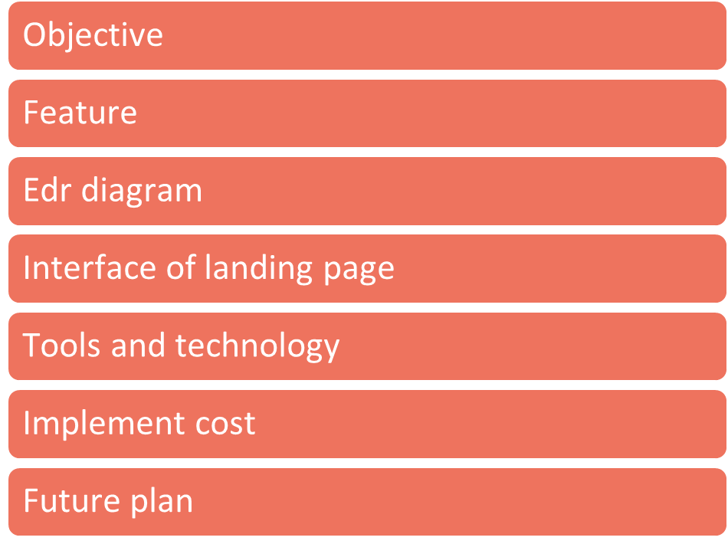
Index of the project

Slide 7
Objectives:
Develop a user-friendly web-based interface for easy access and navigation. Store and manage books and student data securely in a centralized MySQL database. Implement an attendance tracking system to record students check-ins, check-outs, and leaves. Enable the management of student requests, approvals, and tracking. Incorporate a performance evaluation module to assess student performance and track progress. Generate comprehensive reports and analytics on various student metrics. Ensure data integrity, privacy, and security by implementing appropriate authentication and authorization mechanisms.

Slide 8
Software feature
Books information management
Manage Books details
Manage Student details
Manage issue details
Manage report

Slide 9
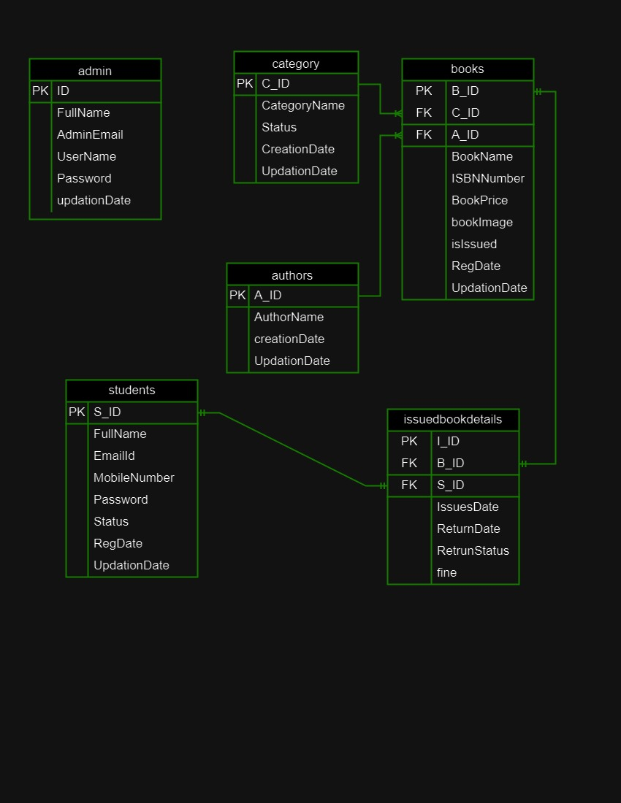
ERD of Library Management System

Slide 10
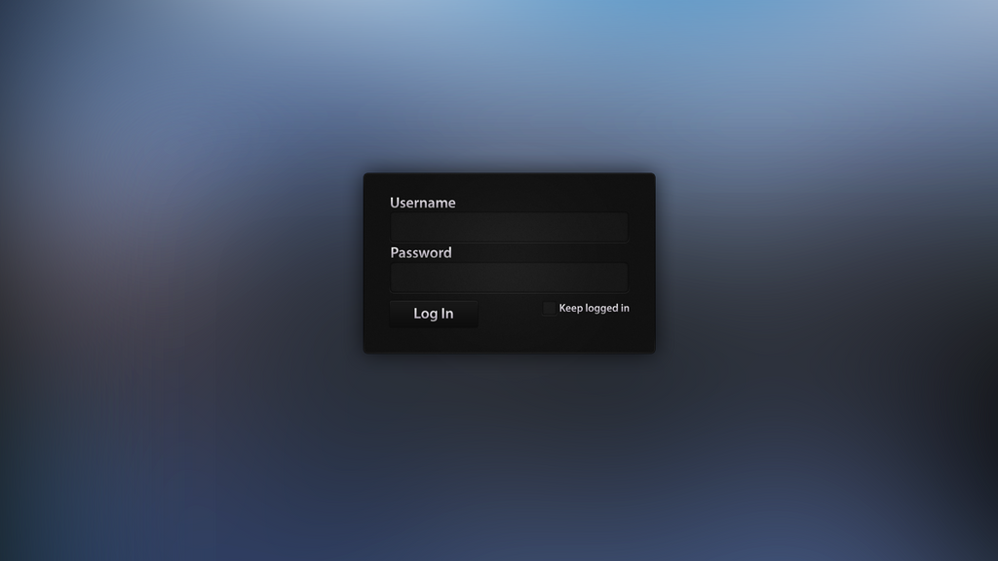

Slide 11
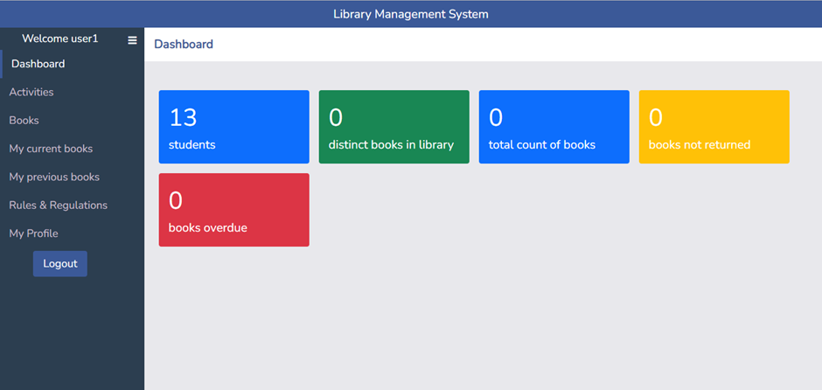

Slide 12






Cost and future
Future
Implementation cost
implementation will cover the following areas:
Core coding of the application.
Database designing.
Frontend design.
Module level unit testing.
Bug fixing and final release including server setup
Add Factorial for Best performance tracking and payroll processing.
More user flexibility.
Reports are Diagram base.
Security Improvement.
Full responsive design.
Bug fixing and improve speed.

Slide 13
Use Of Tools And Technology
Used programing languages:
Server Software Configuration:
Server Hardware Configuration:
This is a web-based software and can be run either offline or online or both systems. It is based on frontend and backend system.
Frontend: Html 5, CSS3, Bootstrap, react
Back end: PHP, MYSQL
Operating System : Windows 7 and higher
Language: PHP,CodeIgniter
Database: MYSQL
Operating System: Windows 7 and higher
Processor: Intel(R) Core(TM) 2Duo CPU @ 2.93 GHZ
RAM : 2 GB
Hard Disk Drive: 20 GB
Keyboard: 122 Keys

Slide 14

Thank you
For being with us ……

